Slide 1
Management Dashboard

Slide 2
Portal Login Page
Enter User Name and password
Click on submit

Slide 3
Dashboard
Register a new complaint
Take action on pending complaints
Check status of individual complaint

Slide 4
Register Complaint
Please fill all required fields for registering new complaint
Please assigned the complaint to the concerned

Slide 5
Pending Complaints
All registered complaints will be in Pending Module
Click on Action button to take action

Slide 6
Required Action On Pending Complaints
Take needful action on the complaint

Slide 7
Transfer Pending Complaints
Select Transfer option from dropdown
Transfer complaint to concerned office

Slide 8
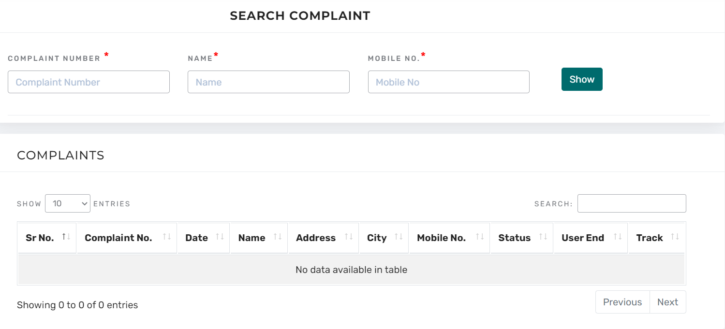
Search Complaint
Search the complaint by Complaint No or Name or Mobile No

Slide 9
Status Of Searched Complaint
Entered Complaint No
Status of search complaint

Slide 10
Detail Report
Download detail report in between date
Download file in the given format

Slide 11
MIS Report
Download MIS Report in required date

